Slide 1

Krishi Setu: Connecting Farmer and Consumer
Group No. 19
Vedangi Naigaonkar 16104046
Shreyas Chorge 17104022
Abhijit Ambre 17104030
Project Guide: Prof. Uttam Kolekar
Project Co-guide:Prof. Anagha Aher
Prof. Neha Deshmukh

Slide 2
Introduction
Farmers these days do not get proper value for the farm produce. They strive so hard yet are compelled to sell their produce at a low price. The middleman forces the farmer to sell his produce at a low rate. These middlemen then sell the same farm produce in the cities or to distributors at a high cost.Thus,the middlemen are at an advantage while the farmers and vendors suffer a huge amount of loss. Sometimes, these middlemen also indulge in malpractices. To overcome this problem, we have developed an idea where these middlemen will almost be eliminated from this system and farmers can directly sell from farm to fork.

Slide 3
Problem Definition
Farmers are not getting paid what the deserve because of all the middlemen like a distributor, retailers, vendors, etc. To overcome this situation, if a farmer wants to sell directly in the market the vendors and buyers they tell them the margin rate which is not at all appropriate according to the current market rates. At this point Farmer cannot take back his goods and supplies since there is a risk of deterioration of goods, so the farmer has to sell his goods at margin rate determined by the vendors and buyers.

Slide 4
Objectives
To build a distributed computing network with kubernetes
To set up scalable image upload
To set up Payments
To let farmers to sell products
To let consumers to buy products

Slide 5
Technological Stack
MongoDB
Express.js
React Native
Node.js
Redis
Docker
Kubernetes

Slide 6
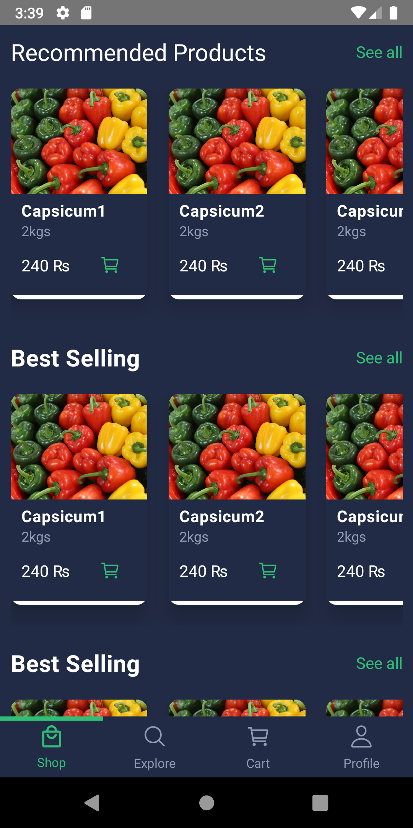
Prototype Design Demonstration
Home Screen

Slide 7
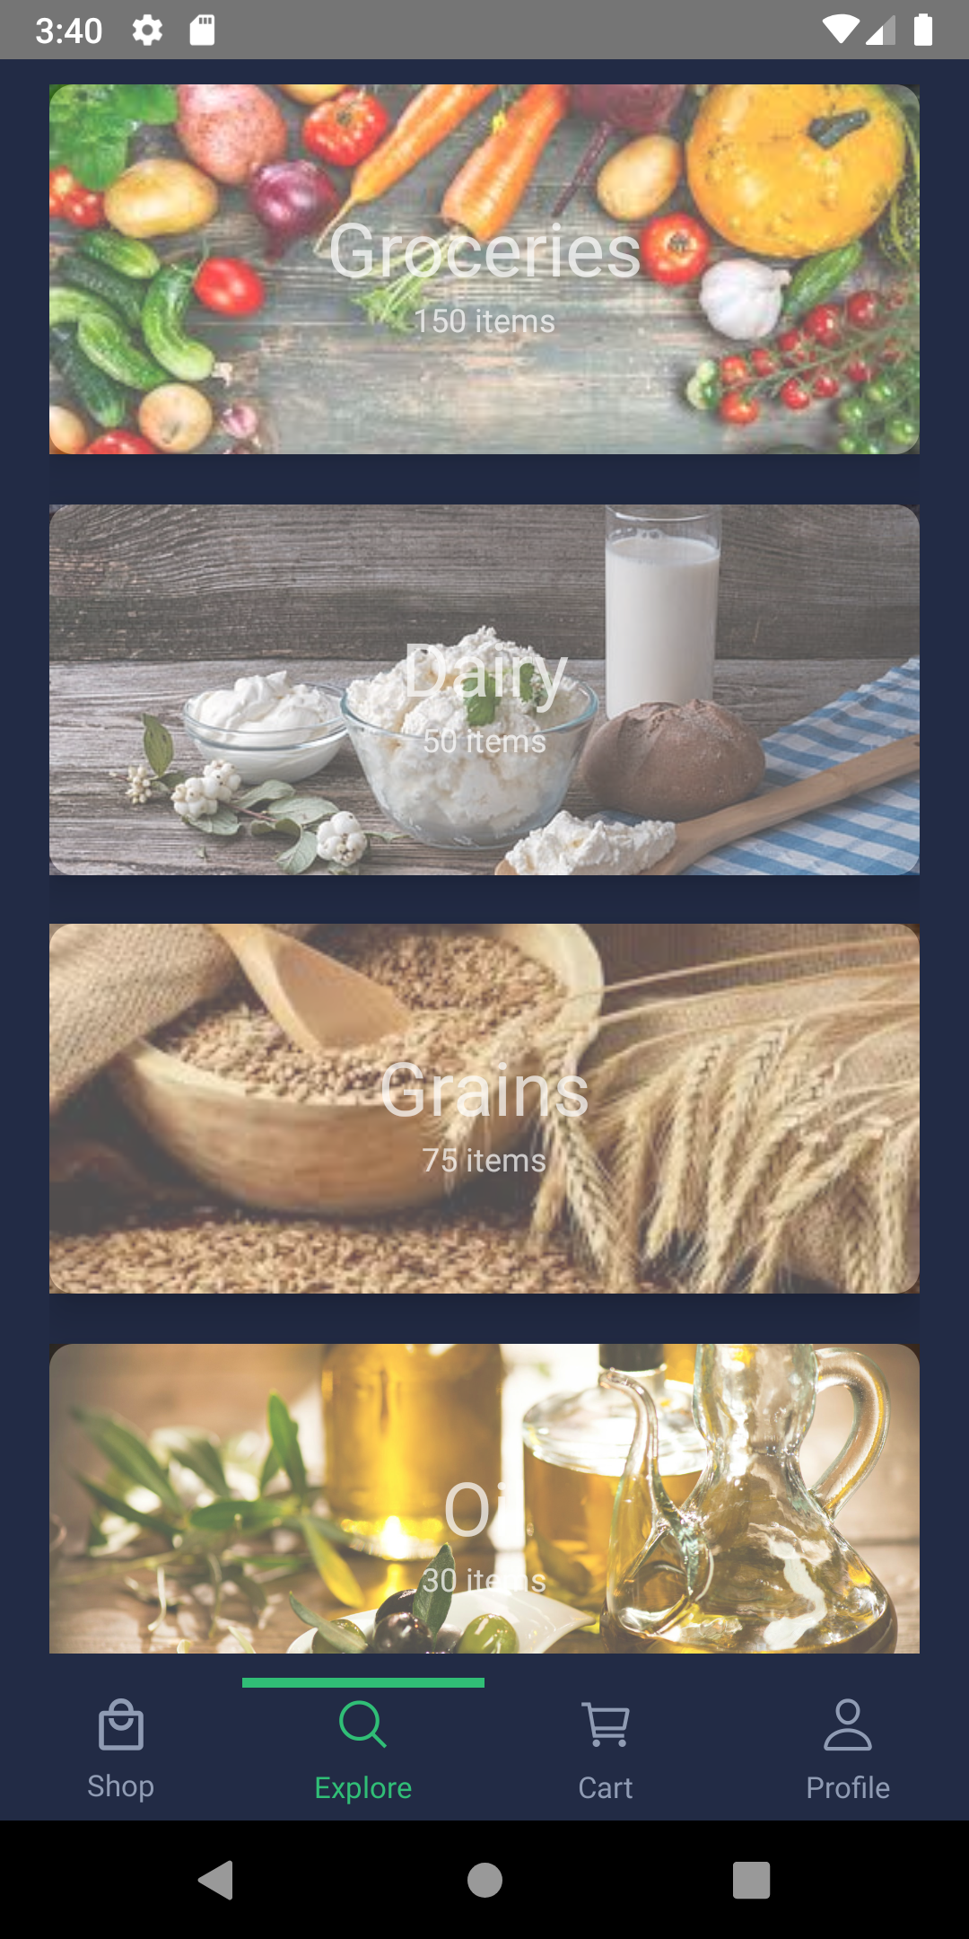
Categories

Slide 8
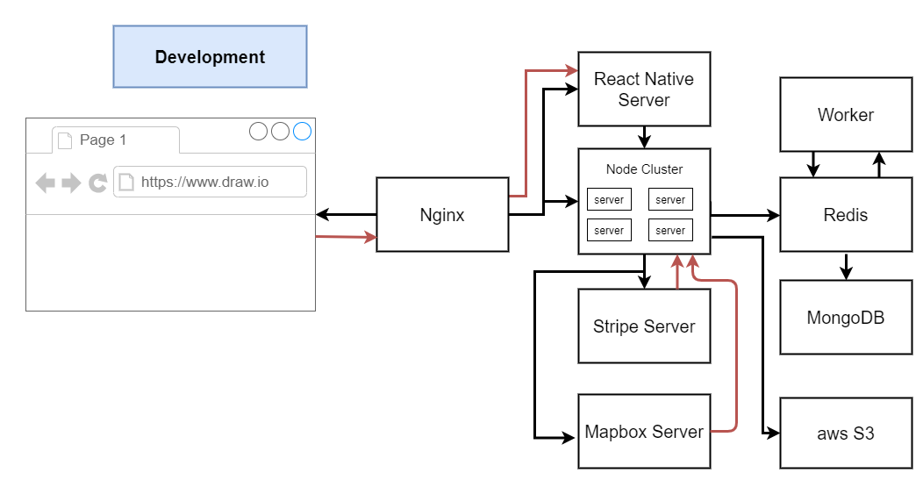
Development Design Architecture

Slide 9
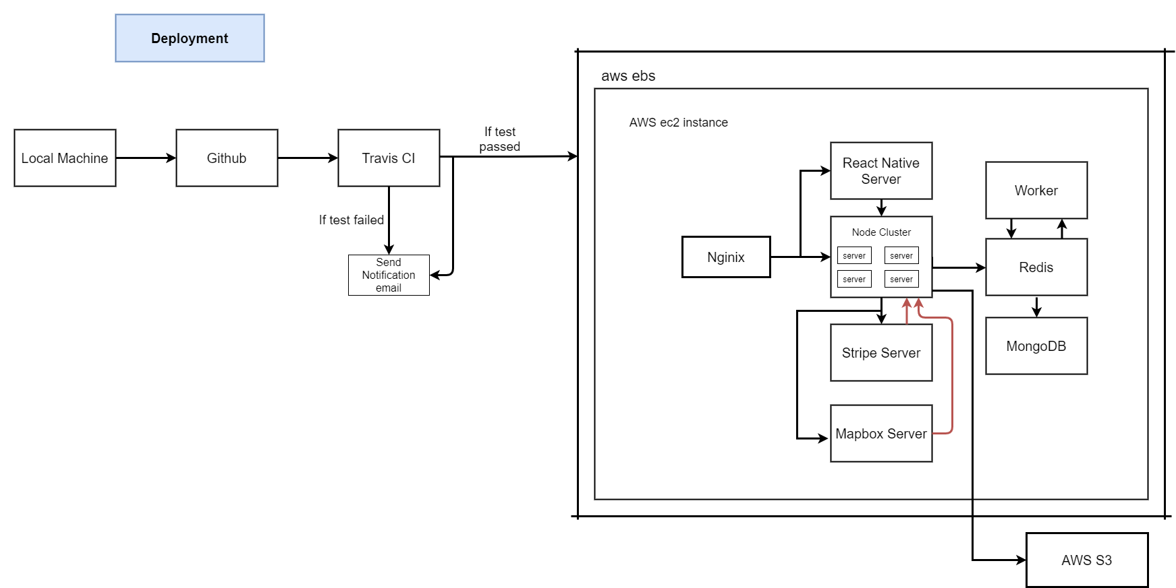
System Design Architecture

Slide 10
Thank You...!!

